Slide 1
LP, NLP and line search
Onsite workshop · Monday, November 9, 2026
90 min review · 10 min break · 80 min new material
Calculate first; use the demo to test your prediction.
2105623 · Onsite workshop
1 / 58
Notes:
Onsite workshop · Monday, November 9, 2026
90 min review · 10 min break · 80 min new material
Calculate first; use the demo to test your prediction.
Reference for line search: Boyd and Vandenberghe, Convex Optimization, Chapter 9. https://web.stanford.edu/~boyd/cvxbook/

Slide 2
Today’s schedule
0–55 min: LP, duality and shadow prices
55–90 min: NLP, gradients and curvature
100–180 min: line search, demos and practice
2105623 · Onsite workshop
2 / 58
Notes:
0–55 min: LP, duality and shadow prices
55–90 min: NLP, gradients and curvature
100–180 min: line search, demos and practice
Reference for line search: Boyd and Vandenberghe, Convex Optimization, Chapter 9. https://web.stanford.edu/~boyd/cvxbook/

Slide 3
Opening questions
Do any resource prices give an upper bound on profit?
Does ∇f = 0 prove that a point is a minimum?
Does a descent direction work with every positive step size?
2105623 · Onsite workshop
3 / 58
Notes:
Do any resource prices give an upper bound on profit?
Does ∇f = 0 prove that a point is a minimum?
Does a descent direction work with every positive step size?
Reference for line search: Boyd and Vandenberghe, Convex Optimization, Chapter 9. https://web.stanford.edu/~boyd/cvxbook/

Slide 4
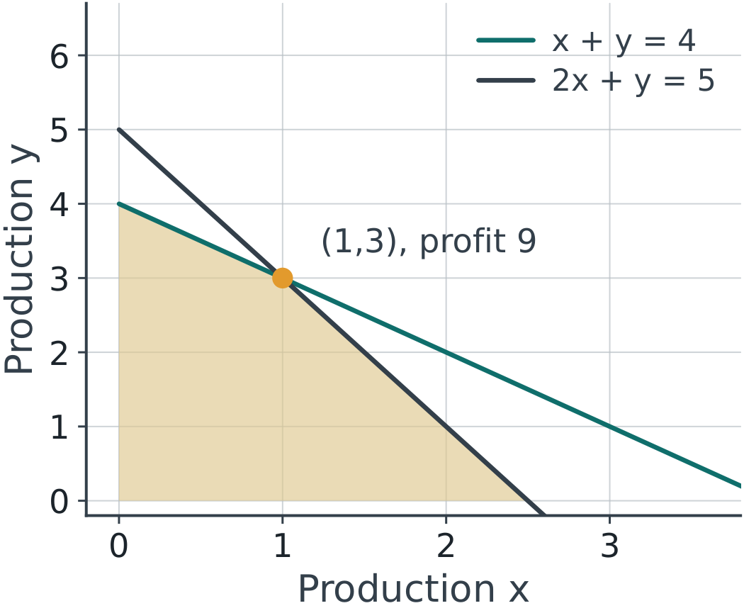
What the primal variables mean
max z = 3x + 2y; x, y ≥ 0
Resource 1: x + y ≤ 4
Resource 2: 2x + y ≤ 5
2105623 · Onsite workshop
4 / 58
Notes:
max z = 3x + 2y; x, y ≥ 0
Resource 1: x + y ≤ 4
Resource 2: 2x + y ≤ 5
Reference for line search: Boyd and Vandenberghe, Convex Optimization, Chapter 9. https://web.stanford.edu/~boyd/cvxbook/

Slide 5
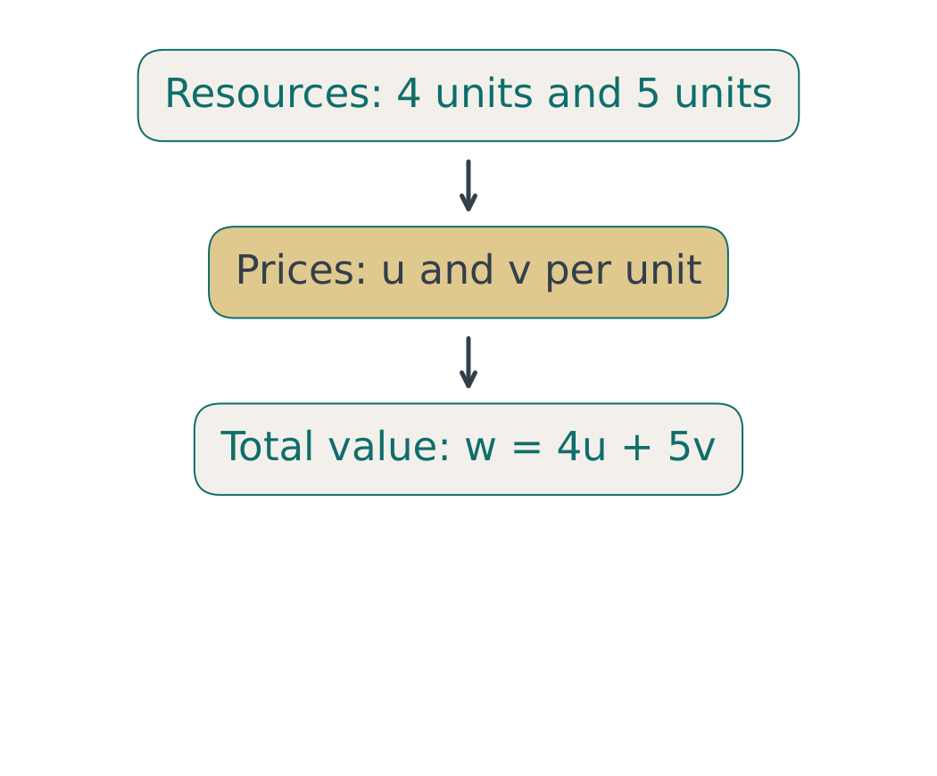
What the dual variables mean
u = price per unit of resource 1
v = price per unit of resource 2
w = 4u + 5v: value of the available resources
2105623 · Onsite workshop
5 / 58
Notes:
u = price per unit of resource 1
v = price per unit of resource 2
w = 4u + 5v: value of the available resources
Reference for line search: Boyd and Vandenberghe, Convex Optimization, Chapter 9. https://web.stanford.edu/~boyd/cvxbook/

Slide 6
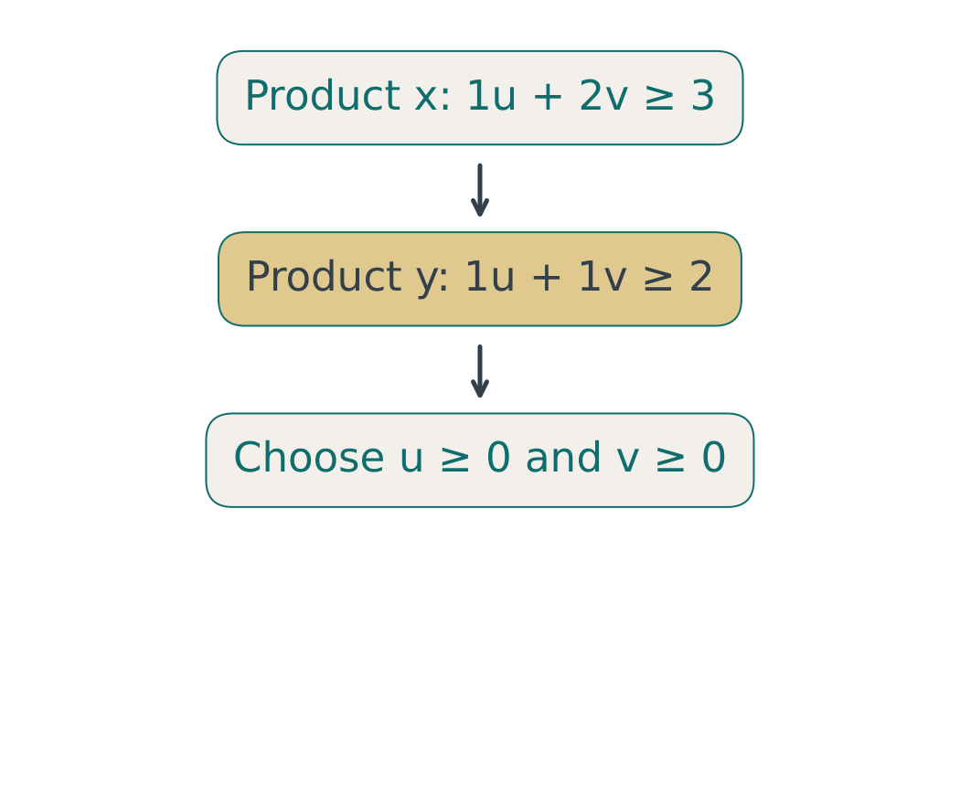
Derive one dual constraint per product
Product x uses (1, 2): cost = u + 2v
Cover its profit: u + 2v ≥ 3
Product y uses (1, 1): u + v ≥ 2
2105623 · Onsite workshop
6 / 58
Notes:
Product x uses (1, 2): cost = u + 2v
Cover its profit: u + 2v ≥ 3
Product y uses (1, 1): u + v ≥ 2
Reference for line search: Boyd and Vandenberghe, Convex Optimization, Chapter 9. https://web.stanford.edu/~boyd/cvxbook/

Slide 7
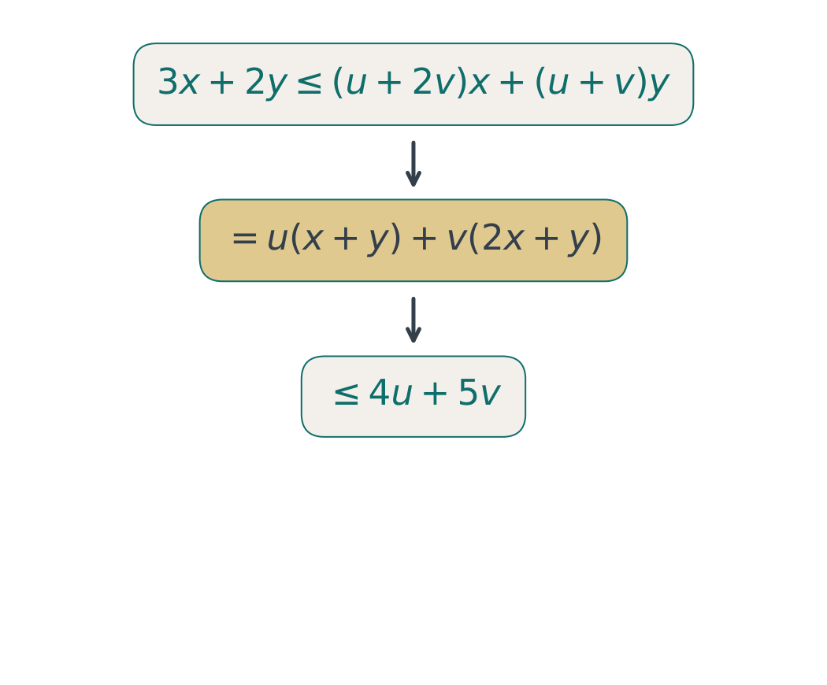
Why the dual gives an upper bound
min w = 4u + 5v; u, v ≥ 0
u + 2v ≥ 3; u + v ≥ 2
For any feasible pair: z ≤ w
2105623 · Onsite workshop
7 / 58
Notes:
min w = 4u + 5v; u, v ≥ 0
u + 2v ≥ 3; u + v ≥ 2
For any feasible pair: z ≤ w
Reference for line search: Boyd and Vandenberghe, Convex Optimization, Chapter 9. https://web.stanford.edu/~boyd/cvxbook/

Slide 8
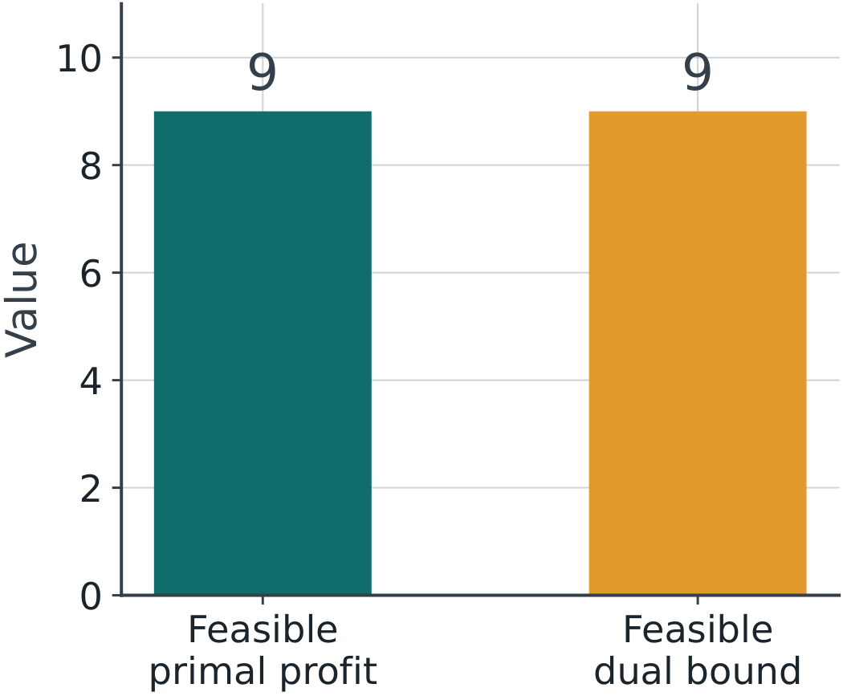
An optimality certificate
Primal (x, y) = (1, 3): z = 9
Dual (u, v) = (1, 1): w = 9
Both are feasible; equal values prove optimality.
2105623 · Onsite workshop
8 / 58
Notes:
Primal (x, y) = (1, 3): z = 9
Dual (u, v) = (1, 1): w = 9
Both are feasible; equal values prove optimality.
Reference for line search: Boyd and Vandenberghe, Convex Optimization, Chapter 9. https://web.stanford.edu/~boyd/cvxbook/

Slide 9
Complementary slackness
Resource slack: s = b − Ax ≥ 0
Pair | Zero-product rule
Resource i | price × unused amount = 0
Product j | quantity × surplus = 0
Product surplus: t = Aᵀλ − c ≥ 0
At optimal feasible pairs: λᵢsᵢ = 0 and xⱼtⱼ = 0.
2105623 · Onsite workshop
9 / 58
Notes:
Resource slack: s = b − Ax ≥ 0
Product surplus: t = Aᵀλ − c ≥ 0
At optimal feasible pairs: λᵢsᵢ = 0 and xⱼtⱼ = 0.
Reference for line search: Boyd and Vandenberghe, Convex Optimization, Chapter 9. https://web.stanford.edu/~boyd/cvxbook/

Slide 10
Check both zero products
At (x,y)=(1,3), resource slacks are (0,0).
Resource | Slack | Price
1 | 0 | 1
2 | 0 | 1
At (u,v)=(1,1), dual surpluses are (0,0).
All four products vanish; z = w = 9.
2105623 · Onsite workshop
10 / 58
Notes:
At (x,y)=(1,3), resource slacks are (0,0).
At (u,v)=(1,1), dual surpluses are (0,0).
All four products vanish; z = w = 9.
Reference for line search: Boyd and Vandenberghe, Convex Optimization, Chapter 9. https://web.stanford.edu/~boyd/cvxbook/

Slide 11
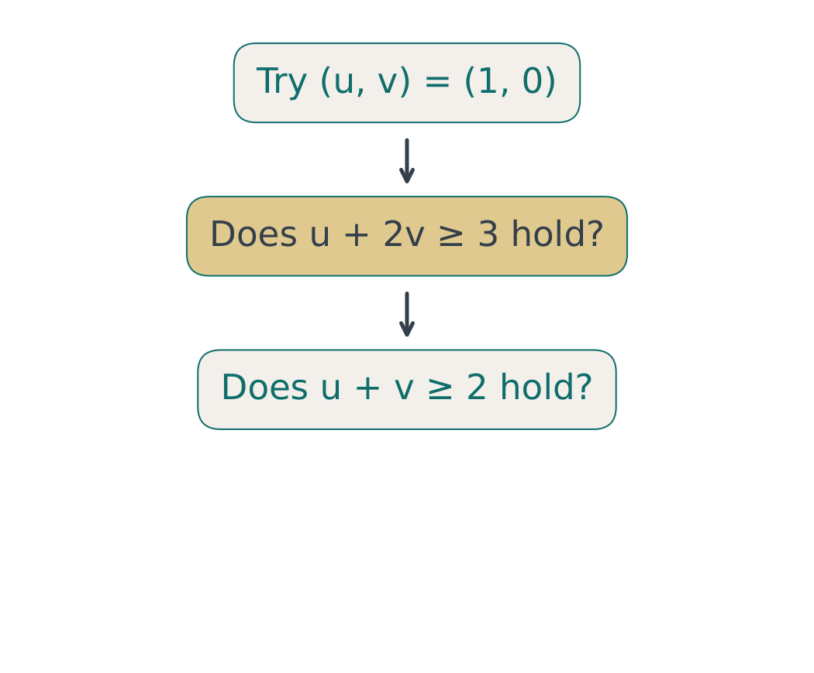
Practice: test a proposed price
Proposed prices: (u, v) = (1, 0)
Check both dual constraints and compute w.
Can w bound every feasible primal profit?
2105623 · Onsite workshop
11 / 58
Notes:
Proposed prices: (u, v) = (1, 0)
Check both dual constraints and compute w.
Can w bound every feasible primal profit?
Reference for line search: Boyd and Vandenberghe, Convex Optimization, Chapter 9. https://web.stanford.edu/~boyd/cvxbook/

Slide 12
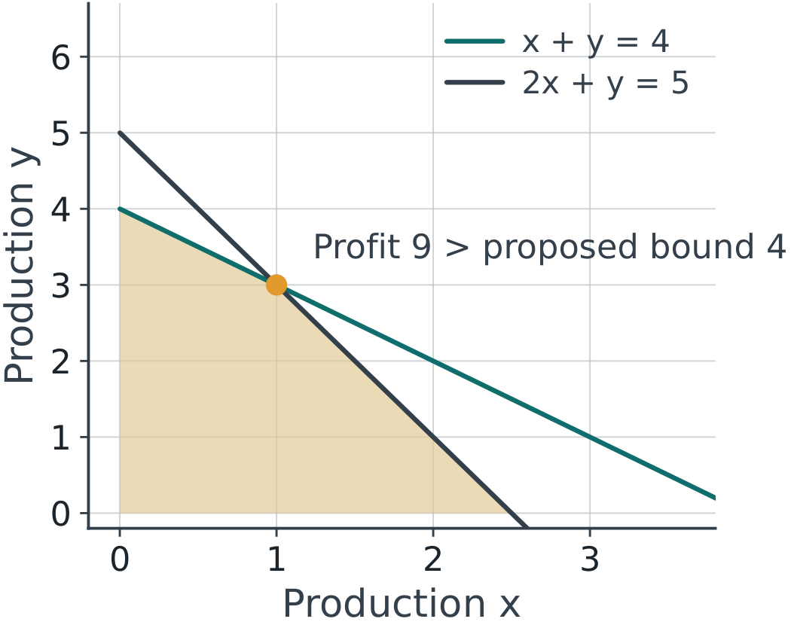
Solution: feasibility comes first
1 + 2(0) = 1 < 3; 1 + 0 = 1 < 2
w = 4, but feasible (1, 3) earns z = 9.
The proposed prices are not dual feasible.
2105623 · Onsite workshop
12 / 58
Notes:
1 + 2(0) = 1 < 3; 1 + 0 = 1 < 2
w = 4, but feasible (1, 3) earns z = 9.
The proposed prices are not dual feasible.
Reference for line search: Boyd and Vandenberghe, Convex Optimization, Chapter 9. https://web.stanford.edu/~boyd/cvxbook/

Slide 13
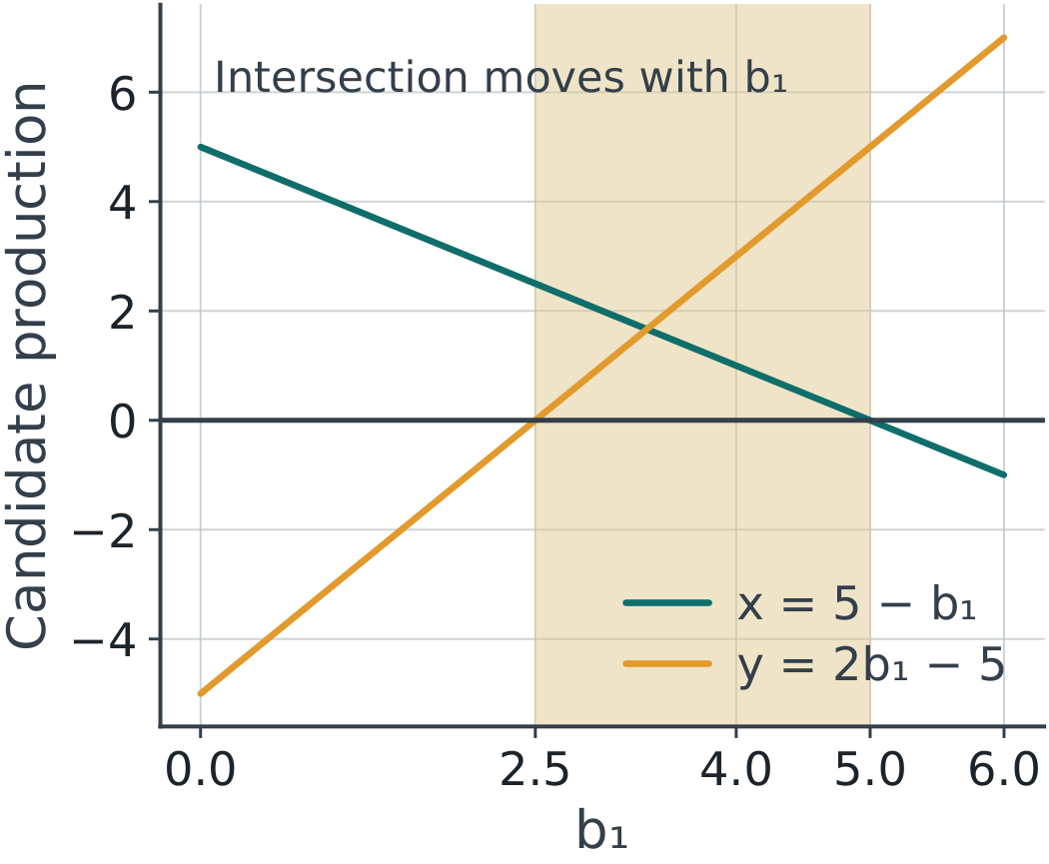
Derive the shadow-price interval
Keep b₂ = 5 and change b₁ only.
Solve x + y = b₁ and 2x + y = 5.
x = 5 − b₁; y = 2b₁ − 5
2105623 · Onsite workshop
13 / 58
Notes:
Keep b₂ = 5 and change b₁ only.
Solve x + y = b₁ and 2x + y = 5.
x = 5 − b₁; y = 2b₁ − 5
Reference for line search: Boyd and Vandenberghe, Convex Optimization, Chapter 9. https://web.stanford.edu/~boyd/cvxbook/

Slide 14
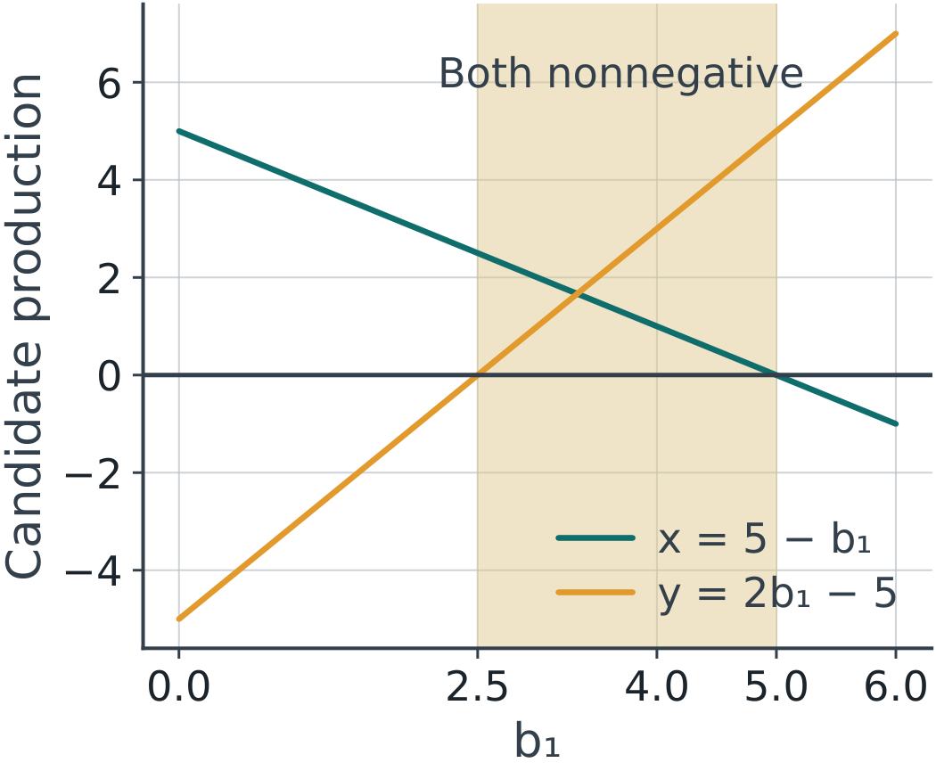
Feasibility determines the interval
x ≥ 0 requires b₁ ≤ 5; y ≥ 0 requires b₁ ≥ 2.5.
On 2.5 ≤ b₁ ≤ 5: primal z = b₁ + 5 = dual w.
At the endpoints, use one-sided slopes.
2105623 · Onsite workshop
14 / 58
Notes:
x ≥ 0 requires b₁ ≤ 5; y ≥ 0 requires b₁ ≥ 2.5.
On 2.5 ≤ b₁ ≤ 5: primal z = b₁ + 5 = dual w.
At the endpoints, use one-sided slopes.
Reference for line search: Boyd and Vandenberghe, Convex Optimization, Chapter 9. https://web.stanford.edu/~boyd/cvxbook/

Slide 15
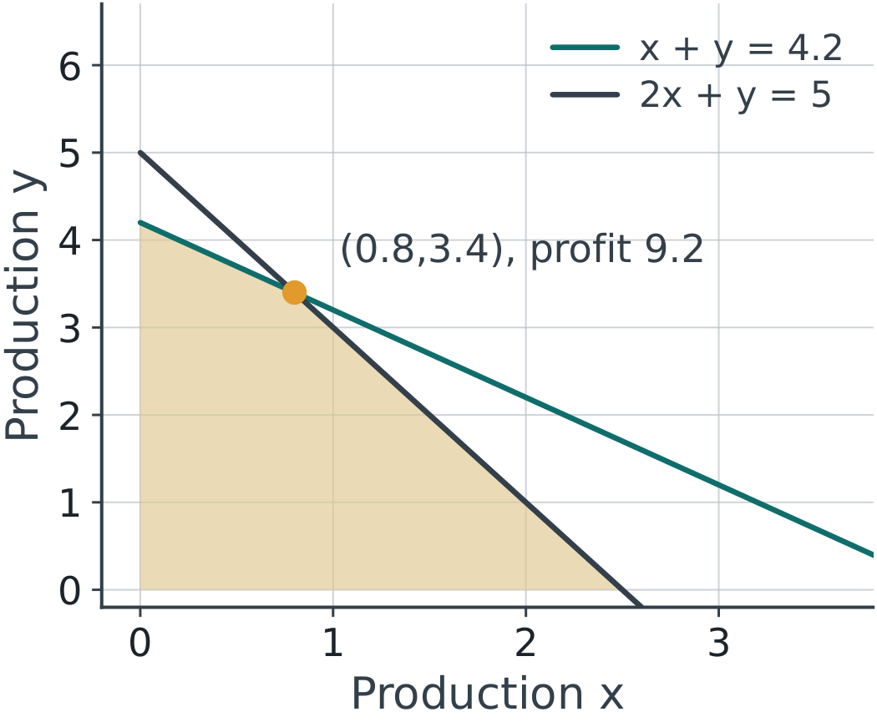
Inside the interval: b₁ = 4.2
x = 0.8; y = 3.4; z = 9.2
Δb₁ = 0.2; Δz = 1 × 0.2 = 0.2
The shadow-price prediction is exact here.
2105623 · Onsite workshop
15 / 58
Notes:
x = 0.8; y = 3.4; z = 9.2
Δb₁ = 0.2; Δz = 1 × 0.2 = 0.2
The shadow-price prediction is exact here.
Reference for line search: Boyd and Vandenberghe, Convex Optimization, Chapter 9. https://web.stanford.edu/~boyd/cvxbook/

Slide 16
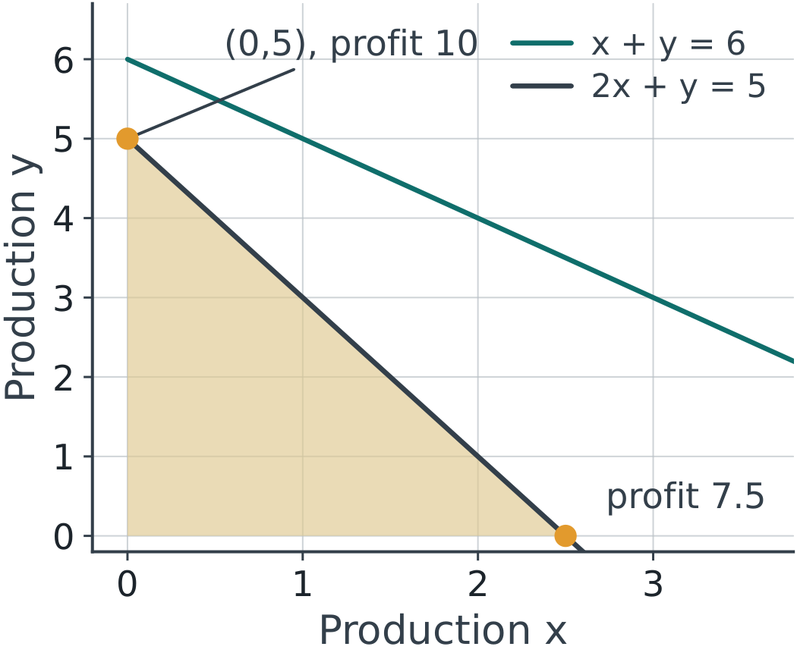
Outside the interval: b₁ = 6
Old intersection: (−1, 7), infeasible.
Old prediction: 9 + 1(6 − 4) = 11.
Reoptimize: (x, y) = (0, 5), z = 10.
2105623 · Onsite workshop
16 / 58
Notes:
Old intersection: (−1, 7), infeasible.
Old prediction: 9 + 1(6 − 4) = 11.
Reoptimize: (x, y) = (0, 5), z = 10.
Reference for line search: Boyd and Vandenberghe, Convex Optimization, Chapter 9. https://web.stanford.edu/~boyd/cvxbook/

Slide 17
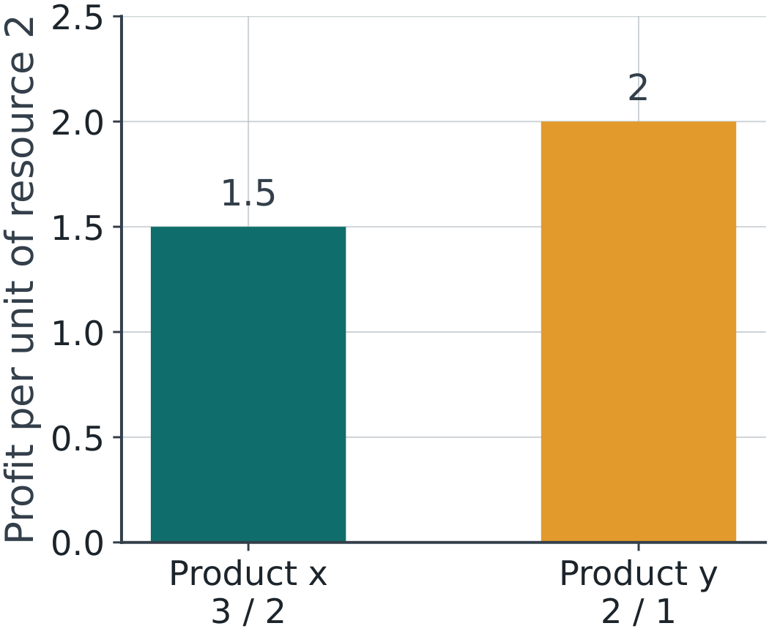
Why producing y gives the larger profit
For b₁ = 6: y ≤ 5 − 2x for every feasible plan.
z = 3x + 2y ≤ 10 − x ≤ 10
Feasible (x,y) = (0,5) attains 10.
2105623 · Onsite workshop
17 / 58
Notes:
For b₁ = 6: y ≤ 5 − 2x for every feasible plan.
z = 3x + 2y ≤ 10 − x ≤ 10
Feasible (x,y) = (0,5) attains 10.
Reference for line search: Boyd and Vandenberghe, Convex Optimization, Chapter 9. https://web.stanford.edu/~boyd/cvxbook/

Slide 18
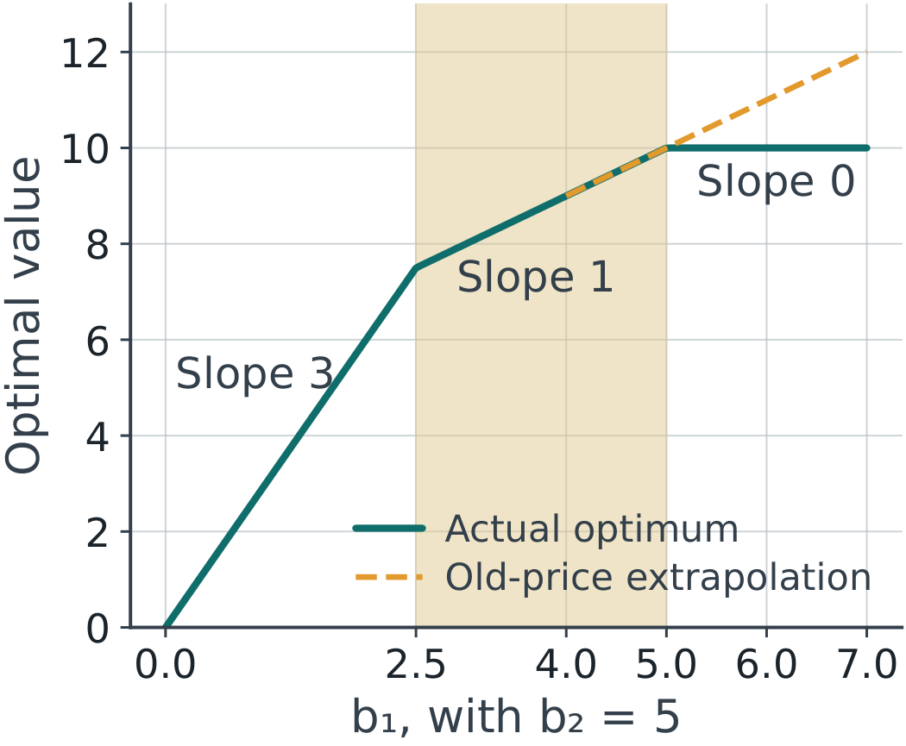
Shadow prices are slopes of the value function
For b₁ ≥ 0: z* = min(3b₁, b₁ + 5, 10)
Slopes: 3, then 1, then 0
Use the slope only within its valid segment.
2105623 · Onsite workshop
18 / 58
Notes:
For b₁ ≥ 0: z* = min(3b₁, b₁ + 5, 10)
Slopes: 3, then 1, then 0
Use the slope only within its valid segment.
Reference for line search: Boyd and Vandenberghe, Convex Optimization, Chapter 9. https://web.stanford.edu/~boyd/cvxbook/

Slide 19
Demo 1: change resource capacity
Predict the optimum at b₁ = 2, 4.2 and 6.
Move the slider; compare actual profit with the old-price prediction.
Watch which resource has unused capacity.
Open demo.html → lp
2105623 · Onsite workshop
19 / 58
Notes:
Predict the optimum at b₁ = 2, 4.2 and 6.
Move the slider; compare actual profit with the old-price prediction.
Watch which resource has unused capacity.
Reference for line search: Boyd and Vandenberghe, Convex Optimization, Chapter 9. https://web.stanford.edu/~boyd/cvxbook/

Slide 20
LP checkpoint
At b₁=6, write the unused amount of each resource.
At b₁=6 | Answer
Primal quantities | (0,5)
Slacks / dual prices | (1,0) / (0,2)
Find feasible dual prices whose value equals 10.
Does an active constraint always have a positive price?
2105623 · Onsite workshop
20 / 58
Notes:
At b₁=6, write the unused amount of each resource.
Find feasible dual prices whose value equals 10.
Does an active constraint always have a positive price?
Reference for line search: Boyd and Vandenberghe, Convex Optimization, Chapter 9. https://web.stanford.edu/~boyd/cvxbook/

Slide 21
From LP to NLP: how we check an answer
LP: dual-feasible prices with w = z certify the optimum.
NLP: ∇f = 0 finds candidates; curvature and convexity classify them.
Line search: the Armijo test checks each trial step before we accept it.
2105623 · Onsite workshop
21 / 58
Notes:
LP: dual-feasible prices with w = z certify the optimum.
NLP: ∇f = 0 finds candidates; curvature and convexity classify them.
Line search: the Armijo test checks each trial step before we accept it.
Reference for line search: Boyd and Vandenberghe, Convex Optimization, Chapter 9. https://web.stanford.edu/~boyd/cvxbook/

Slide 22
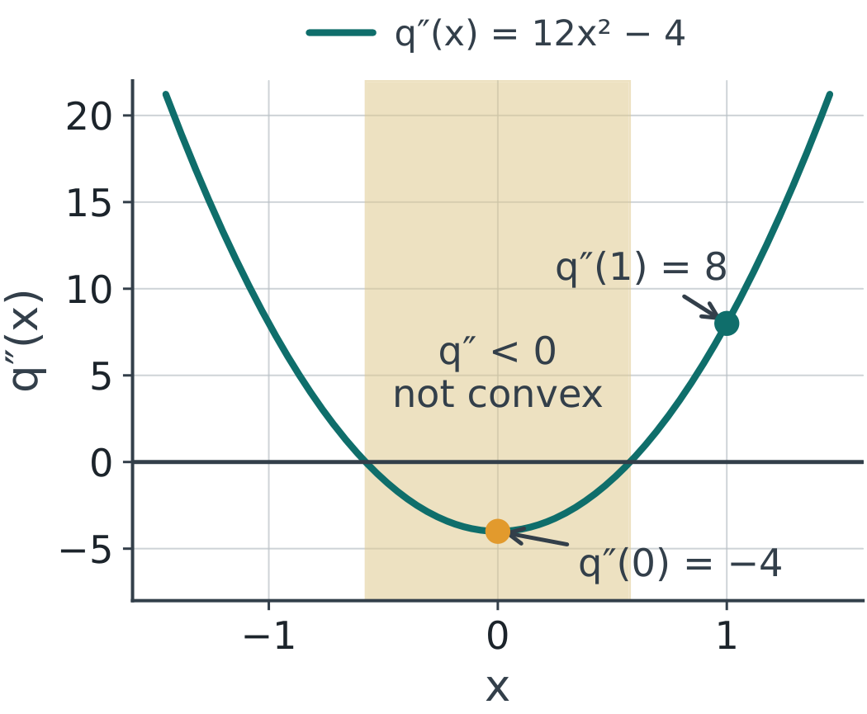
Convexity requires a domain-wide check
Assume f is C² on an open convex domain.
Convex ⇔ Hessian is positive semidefinite everywhere.
One point is not enough: q = (x²−1)² has q″(1) = 8 but q″(0) = −4.
2105623 · Onsite workshop
22 / 58
Notes:
Assume f is C² on an open convex domain.
Convex ⇔ Hessian is positive semidefinite everywhere.
One point is not enough: q = (x²−1)² has q″(1) = 8 but q″(0) = −4.
Reference for line search: Boyd and Vandenberghe, Convex Optimization, Chapter 9. https://web.stanford.edu/~boyd/cvxbook/

Slide 23
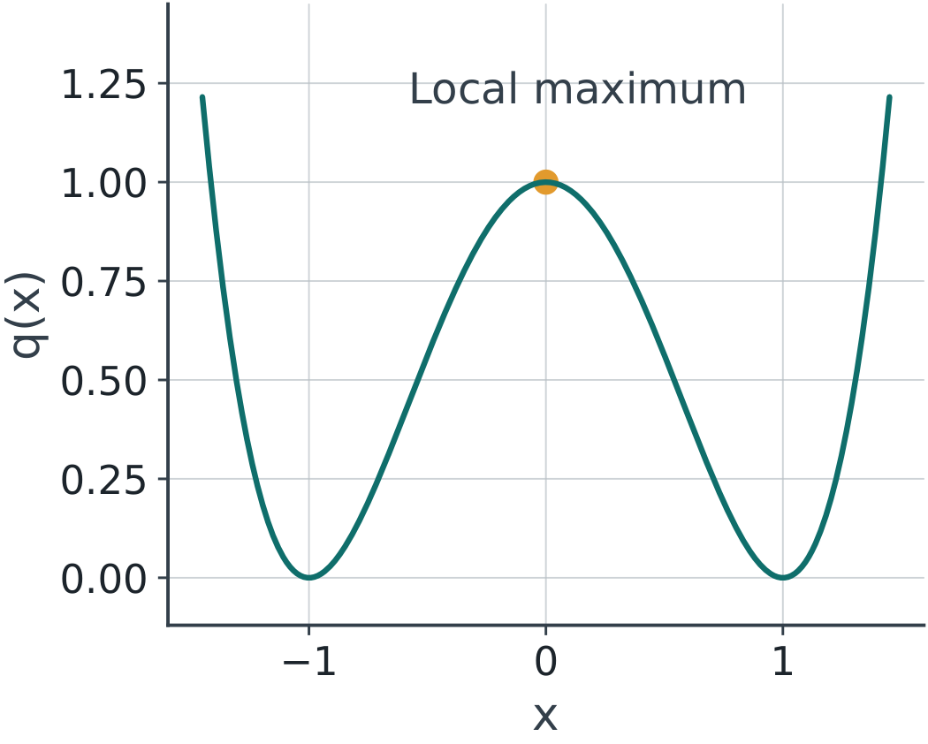
A stationary point may be a maximum
q(x) = (x² − 1)²
q′(x) = 4x(x² − 1); q″(x) = 12x² − 4
At x = 0: q′ = 0, q″ = −4 < 0.
2105623 · Onsite workshop
23 / 58
Notes:
q(x) = (x² − 1)²
q′(x) = 4x(x² − 1); q″(x) = 12x² − 4
At x = 0: q′ = 0, q″ = −4 < 0.
Reference for line search: Boyd and Vandenberghe, Convex Optimization, Chapter 9. https://web.stanford.edu/~boyd/cvxbook/

Slide 24
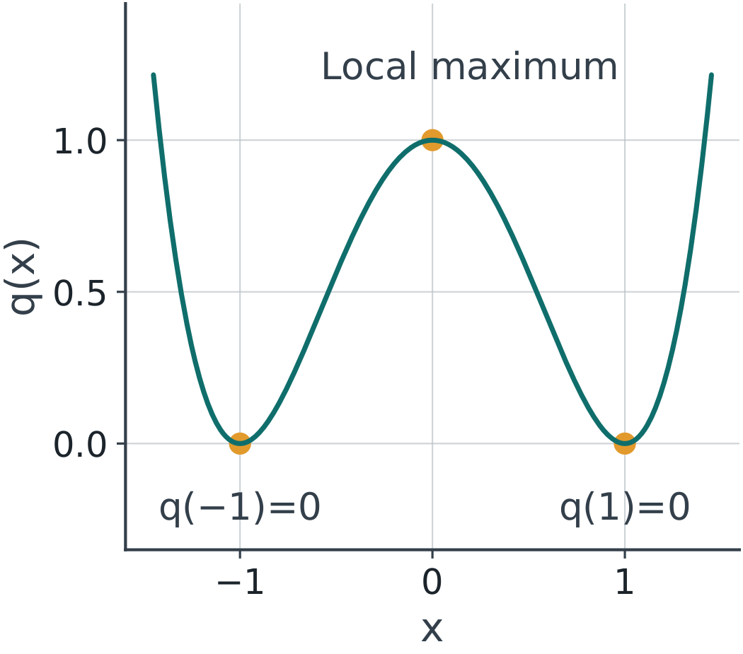
Check values and classify the point
q(0) = 1; q(−1) = q(1) = 0
q(x) ≥ 0 for every real x.
Thus x = ±1 are global minima; x = 0 is a local maximum.
2105623 · Onsite workshop
24 / 58
Notes:
q(0) = 1; q(−1) = q(1) = 0
q(x) ≥ 0 for every real x.
Thus x = ±1 are global minima; x = 0 is a local maximum.
Reference for line search: Boyd and Vandenberghe, Convex Optimization, Chapter 9. https://web.stanford.edu/~boyd/cvxbook/

Slide 25
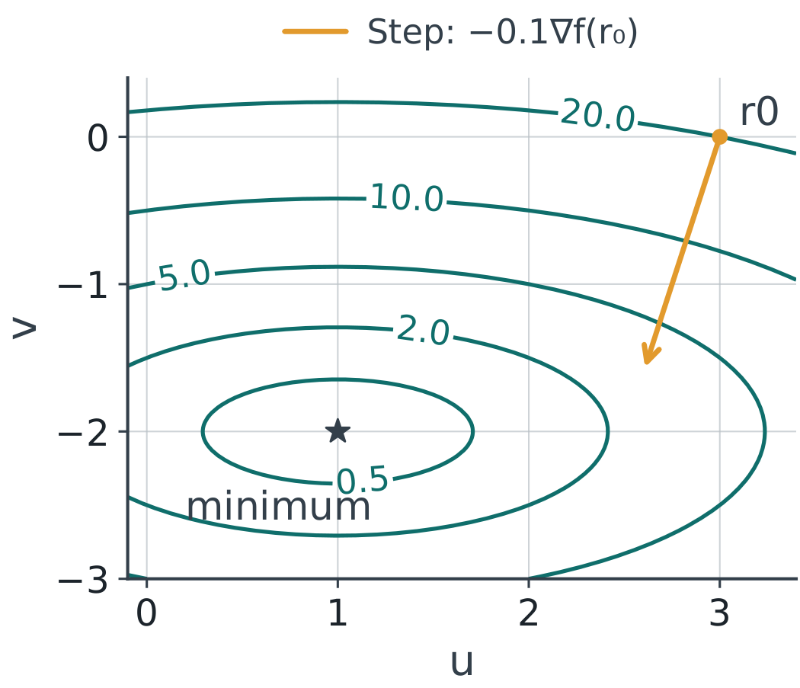
Gradient descent: compute the gradient
NLP coordinates u,v: f = (u−1)² + 4(v+2)²
∇f = (2(u−1), 8(v+2)); Hessian diag(2, 8) is positive definite everywhere.
So f is convex and (1,−2) is its global minimum. At (3,0): ∇f = (4,16), f = 20.
2105623 · Onsite workshop
25 / 58
Notes:
NLP coordinates u,v: f = (u−1)² + 4(v+2)²
∇f = (2(u−1), 8(v+2)); Hessian diag(2, 8) is positive definite everywhere.
So f is convex and (1,−2) is its global minimum. At (3,0): ∇f = (4,16), f = 20.
Reference for line search: Boyd and Vandenberghe, Convex Optimization, Chapter 9. https://web.stanford.edu/~boyd/cvxbook/

Slide 26
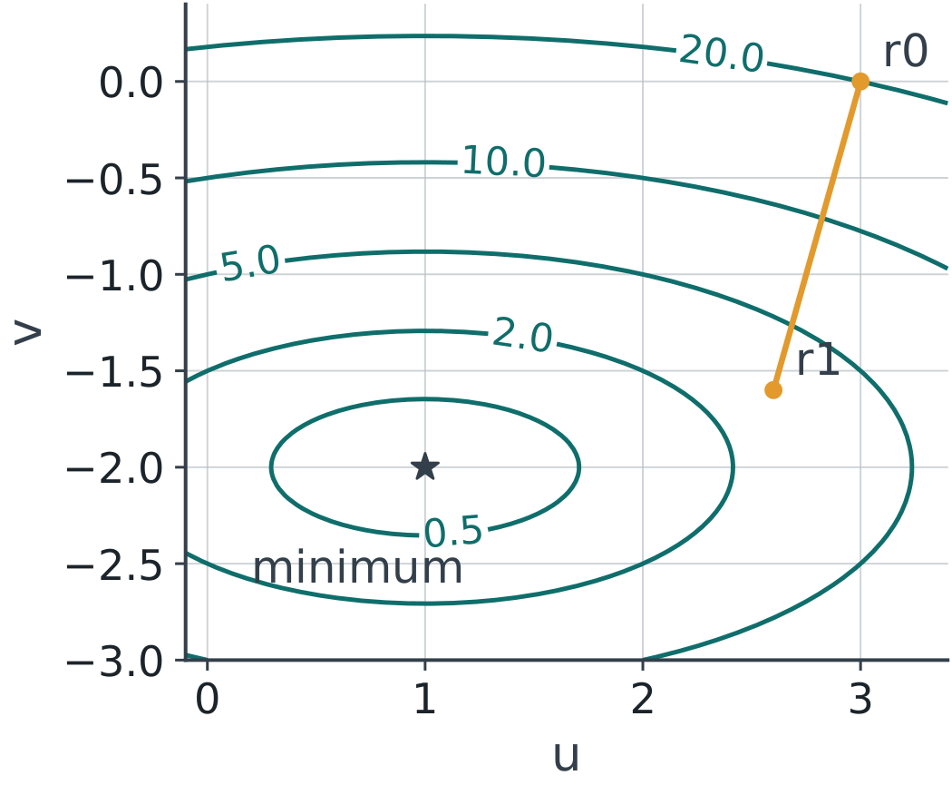
One gradient step is not the optimum
Let rₖ = (uₖ,vₖ). Use α = 0.1: r₁ = r₀ − α∇f(r₀).
(u₁,v₁) = (3,0) − 0.1(4,16) = (2.6,−1.6)
f(r₁) = 1.6² + 4(0.4)² = 3.2
2105623 · Onsite workshop
26 / 58
Notes:
Let rₖ = (uₖ,vₖ). Use α = 0.1: r₁ = r₀ − α∇f(r₀).
(u₁,v₁) = (3,0) − 0.1(4,16) = (2.6,−1.6)
f(r₁) = 1.6² + 4(0.4)² = 3.2
Reference for line search: Boyd and Vandenberghe, Convex Optimization, Chapter 9. https://web.stanford.edu/~boyd/cvxbook/

Slide 27
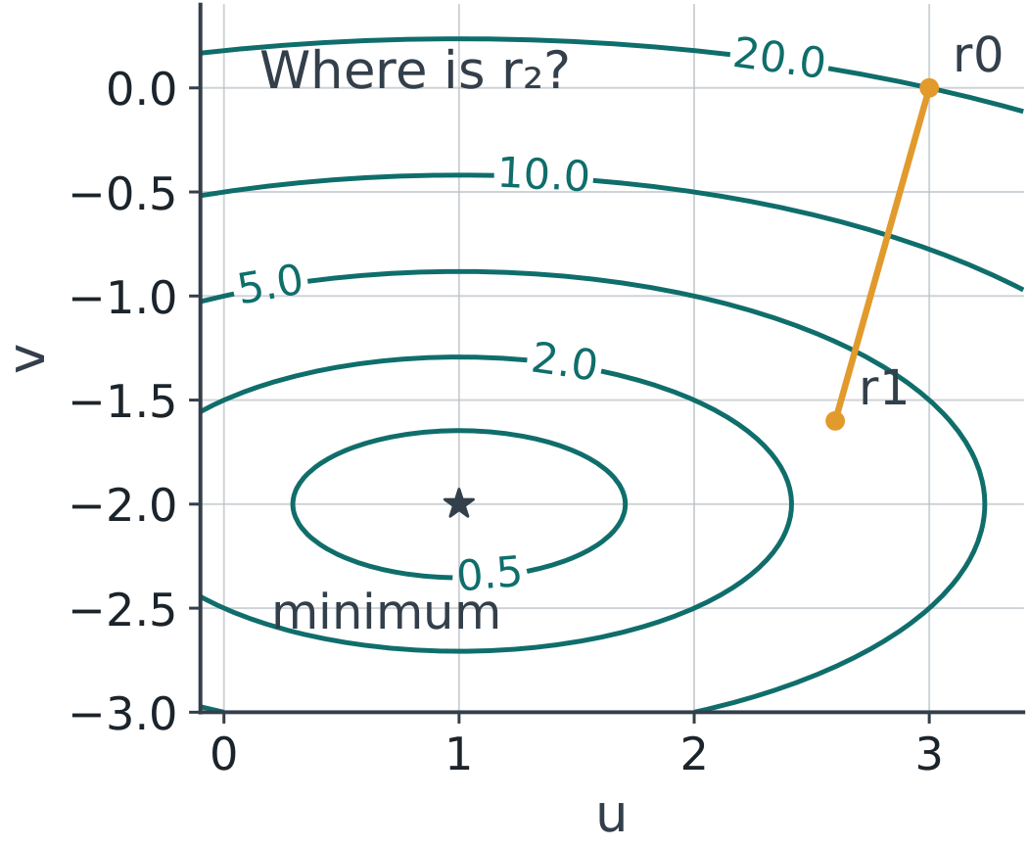
Practice: compute the second step
Start now at (2.6, −1.6); keep α = 0.1.
Compute the new gradient, point, and objective.
Does reusing the old gradient give the same method?
2105623 · Onsite workshop
27 / 58
Notes:
Start now at (2.6, −1.6); keep α = 0.1.
Compute the new gradient, point, and objective.
Does reusing the old gradient give the same method?
Reference for line search: Boyd and Vandenberghe, Convex Optimization, Chapter 9. https://web.stanford.edu/~boyd/cvxbook/

Slide 28
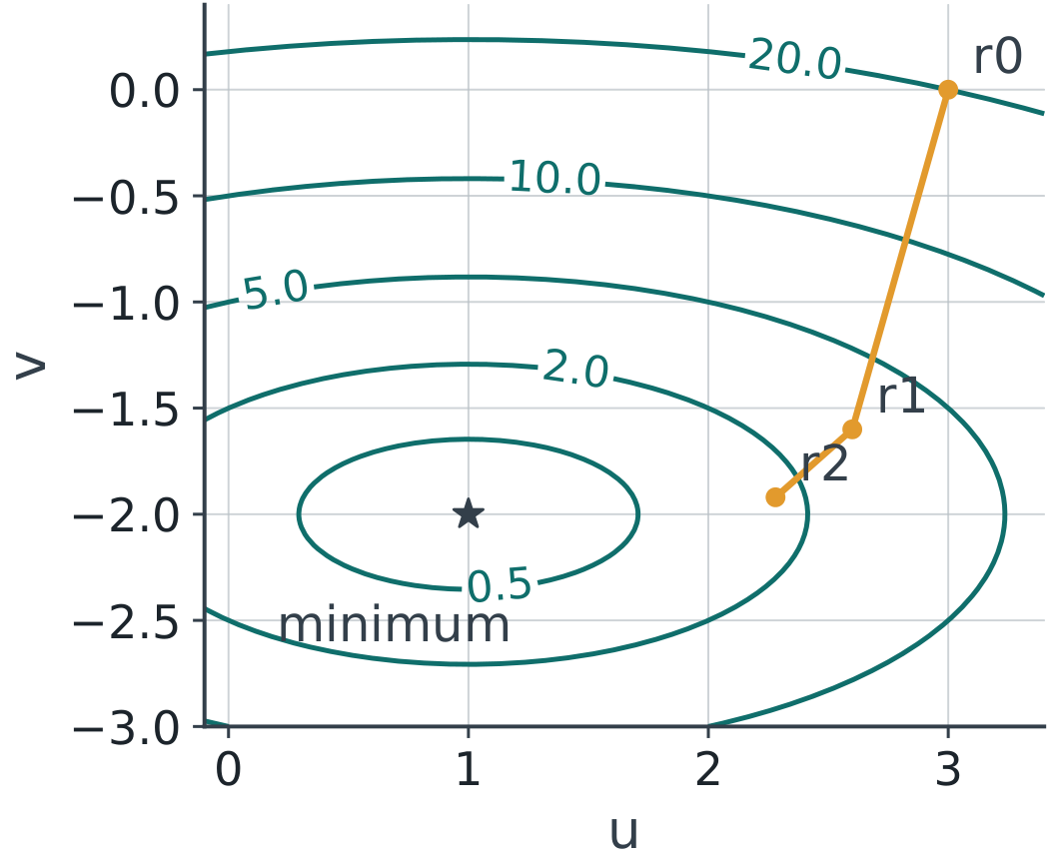
Solution: update the gradient every time
∇f(2.6,−1.6) = (3.2,3.2)
r₂ = (2.6,−1.6) − 0.1(3.2,3.2) = (2.28,−1.92)
f(r₂) = 1.28² + 4(0.08)² = 1.664
2105623 · Onsite workshop
28 / 58
Notes:
∇f(2.6,−1.6) = (3.2,3.2)
r₂ = (2.6,−1.6) − 0.1(3.2,3.2) = (2.28,−1.92)
f(r₂) = 1.28² + 4(0.08)² = 1.664
Reference for line search: Boyd and Vandenberghe, Convex Optimization, Chapter 9. https://web.stanford.edu/~boyd/cvxbook/

Slide 29
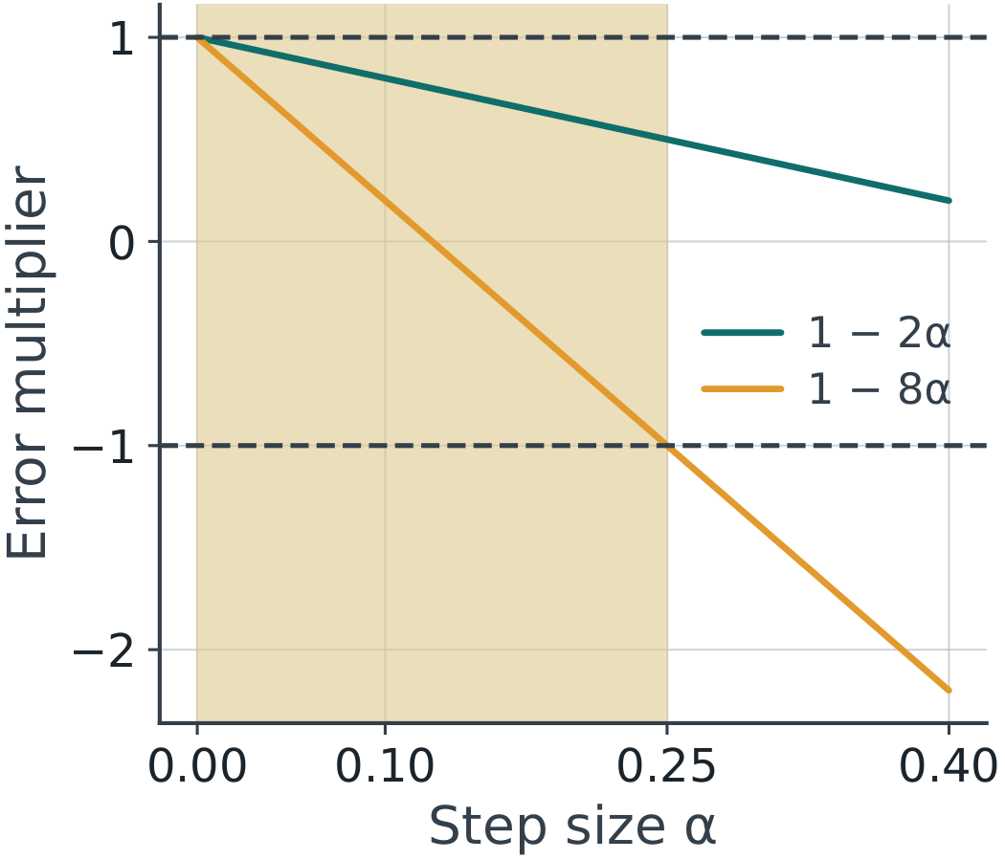
Derive the constant-step convergence range
Let eᵤ = u−1 and eᵥ = v+2.
eᵤ,new = (1−2α)eᵤ; eᵥ,new = (1−8α)eᵥ
Both shrink for every start when 0 < α < 0.25.
2105623 · Onsite workshop
29 / 58
Notes:
Let eᵤ = u−1 and eᵥ = v+2.
eᵤ,new = (1−2α)eᵤ; eᵥ,new = (1−8α)eᵥ
Both shrink for every start when 0 < α < 0.25.
Reference for line search: Boyd and Vandenberghe, Convex Optimization, Chapter 9. https://web.stanford.edu/~boyd/cvxbook/

Slide 30
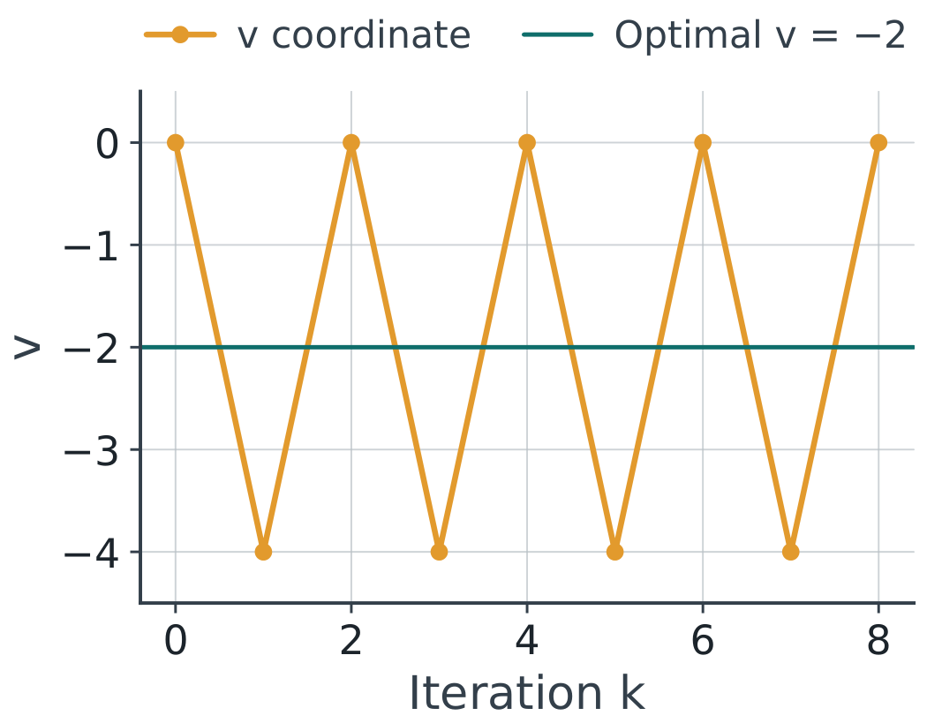
At α = 0.25, one coordinate oscillates
eᵤ multiplier = 0.5; eᵥ multiplier = −1.
From (3,0), v alternates: 0, −4, 0, −4, …
f(rₖ) = 4(1/4)ᵏ + 16 → 16, not 0.
2105623 · Onsite workshop
30 / 58
Notes:
eᵤ multiplier = 0.5; eᵥ multiplier = −1.
From (3,0), v alternates: 0, −4, 0, −4, …
f(rₖ) = 4(1/4)ᵏ + 16 → 16, not 0.
Reference for line search: Boyd and Vandenberghe, Convex Optimization, Chapter 9. https://web.stanford.edu/~boyd/cvxbook/

Slide 31
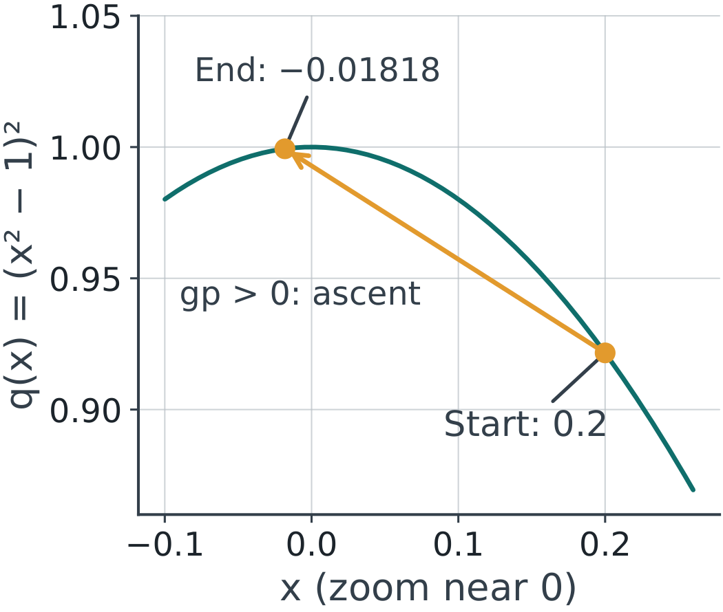
Newton directions also need a check
p = −g/H in one dimension.
At x = 0.2 for q: g = −0.768, H = −3.52.
p ≈ −0.21818; full step x+p ≈ −0.01818.
2105623 · Onsite workshop
31 / 58
Notes:
p = −g/H in one dimension.
At x = 0.2 for q: g = −0.768, H = −3.52.
p ≈ −0.21818; full step x+p ≈ −0.01818.
Reference for line search: Boyd and Vandenberghe, Convex Optimization, Chapter 9. https://web.stanford.edu/~boyd/cvxbook/

Slide 32
NLP checkpoint
For q(x)=(x²−1)², classify x=0 and x=±1.
For the quadratic, explain why α=0.25 can fail if kept fixed.
Before line search, what sign should gᵀp have?
2105623 · Onsite workshop
32 / 58
Notes:
For q(x)=(x²−1)², classify x=0 and x=±1.
For the quadratic, explain why α=0.25 can fail if kept fixed.
Before line search, what sign should gᵀp have?
Reference for line search: Boyd and Vandenberghe, Convex Optimization, Chapter 9. https://web.stanford.edu/~boyd/cvxbook/

Slide 33
Break · 10 minutes
Keep the quadratic and the starting point in your notes.
f(u,v) = (u−1)² + 4(v+2)²; r₀=(3,0)
Next: choose a step size automatically.
2105623 · Onsite workshop
33 / 58
Notes:
Keep the quadratic and the starting point in your notes.
f(u,v) = (u−1)² + 4(v+2)²; r₀=(3,0)
Next: choose a step size automatically.
Reference for line search: Boyd and Vandenberghe, Convex Optimization, Chapter 9. https://web.stanford.edu/~boyd/cvxbook/

Slide 34
Direction and step size
rₖ₊₁ = rₖ + αₖpₖ, with αₖ > 0
αₖ is the step size (textbooks: step length); distance moved = αₖ‖pₖ‖.
For gradient descent, pₖ = −∇f(rₖ).
2105623 · Onsite workshop
34 / 58
Notes:
rₖ₊₁ = rₖ + αₖpₖ, with αₖ > 0
αₖ is the step size (textbooks: step length); distance moved = αₖ‖pₖ‖.
For gradient descent, pₖ = −∇f(rₖ).
Reference for line search: Boyd and Vandenberghe, Convex Optimization, Chapter 9. https://web.stanford.edu/~boyd/cvxbook/

Slide 35
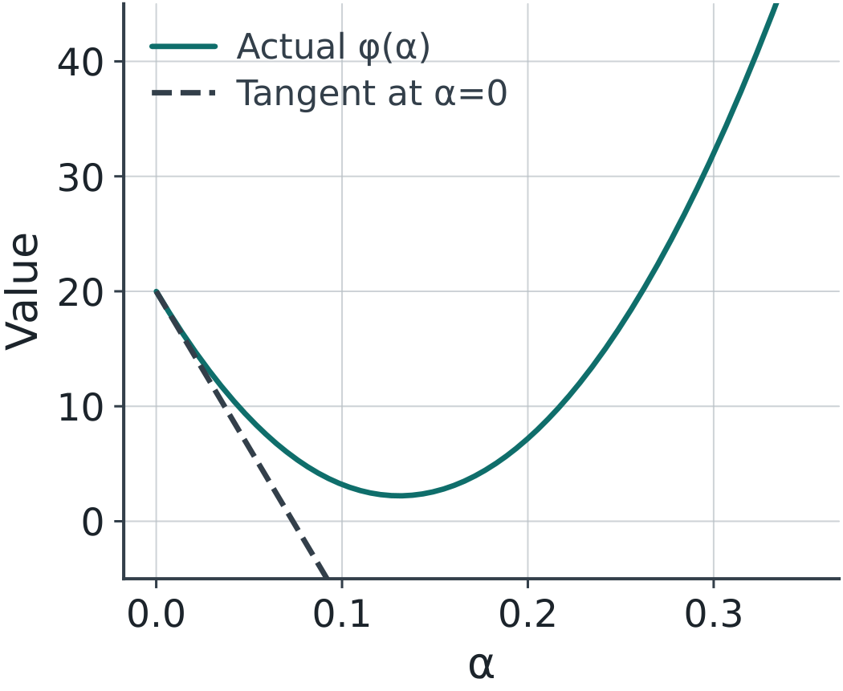
Check the direction first
With g = ∇f(r), require gᵀp < 0 for descent.
For p=−g and g≠0: gᵀp = −‖g‖² < 0.
This guarantees decrease for sufficiently small positive α.
2105623 · Onsite workshop
35 / 58
Notes:
With g = ∇f(r), require gᵀp < 0 for descent.
For p=−g and g≠0: gᵀp = −‖g‖² < 0.
This guarantees decrease for sufficiently small positive α.
Reference for line search: Boyd and Vandenberghe, Convex Optimization, Chapter 9. https://web.stanford.edu/~boyd/cvxbook/

Slide 36
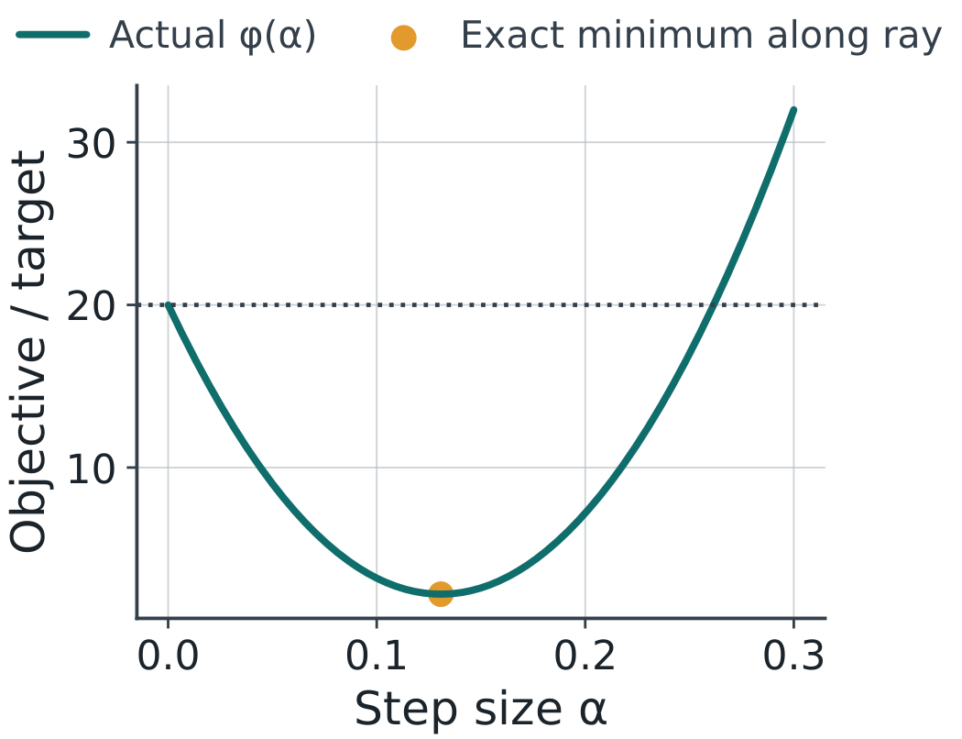
A one-dimensional function along the ray
At r₀=(3,0): g₀=(4,16), p₀=(−4,−16).
φ(α) = f(3−4α, −16α)
φ(α) = 20 − 272α + 1040α²
2105623 · Onsite workshop
36 / 58
Notes:
At r₀=(3,0): g₀=(4,16), p₀=(−4,−16).
φ(α) = f(3−4α, −16α)
φ(α) = 20 − 272α + 1040α²
Reference for line search: Boyd and Vandenberghe, Convex Optimization, Chapter 9. https://web.stanford.edu/~boyd/cvxbook/

Slide 37
Exact line search for this quadratic
φ′(α) = −272 + 2080α
α* = 272/2080 = 17/130 ≈ 0.13077
φ(α*) = 144/65 ≈ 2.21538
2105623 · Onsite workshop
37 / 58
Notes:
φ′(α) = −272 + 2080α
α* = 272/2080 = 17/130 ≈ 0.13077
φ(α*) = 144/65 ≈ 2.21538
Reference for line search: Boyd and Vandenberghe, Convex Optimization, Chapter 9. https://web.stanford.edu/~boyd/cvxbook/

Slide 38
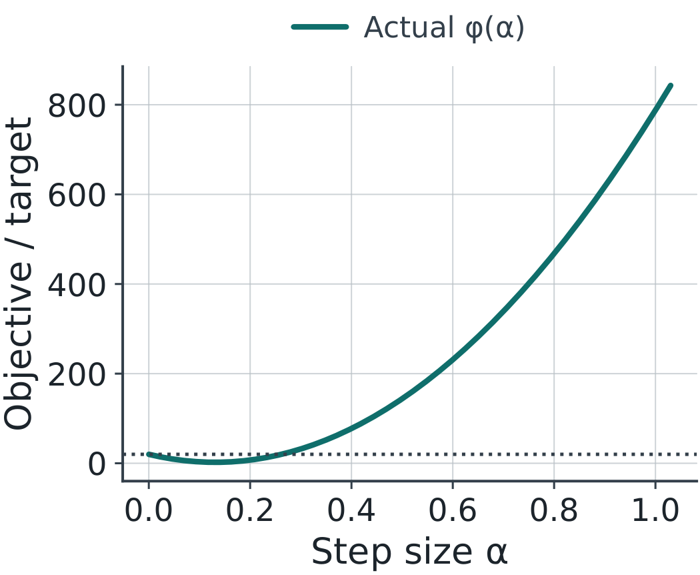
A large step can increase the objective
At α=1: r₁=(−1,−16), f=788.
At α=0.5: r₁=(1,−8), f=144.
Both exceed f(r₀)=20, despite g₀ᵀp₀<0.
2105623 · Onsite workshop
38 / 58
Notes:
At α=1: r₁=(−1,−16), f=788.
At α=0.5: r₁=(1,−8), f=144.
Both exceed f(r₀)=20, despite g₀ᵀp₀<0.
Reference for line search: Boyd and Vandenberghe, Convex Optimization, Chapter 9. https://web.stanford.edu/~boyd/cvxbook/

Slide 39
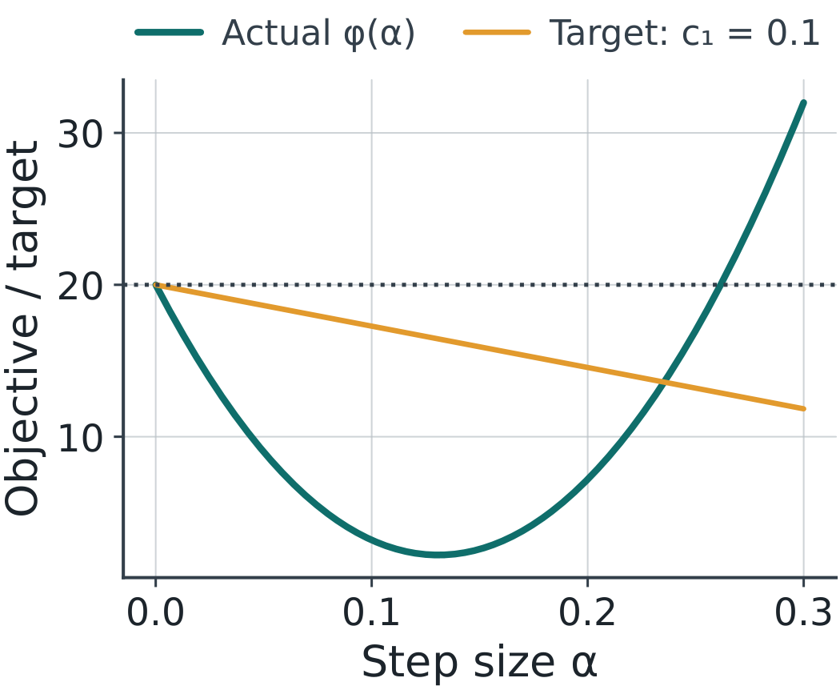
Armijo sufficient decrease
Accept α if f(r+αp) ≤ f(r) + c₁αgᵀp.
Choose 0<c₁<1 and require gᵀp<0.
The accepted value must beat a target below f(r).
2105623 · Onsite workshop
39 / 58
Notes:
Accept α if f(r+αp) ≤ f(r) + c₁αgᵀp.
Choose 0<c₁<1 and require gᵀp<0.
The accepted value must beat a target below f(r).
Reference for line search: Boyd and Vandenberghe, Convex Optimization, Chapter 9. https://web.stanford.edu/~boyd/cvxbook/

Slide 40
Backtracking parameters
Start each search with α₀=1.
Here: c₁=0.1 and ρ=0.5.
If Armijo fails, replace α by ρα and test again.
2105623 · Onsite workshop
40 / 58
Notes:
Start each search with α₀=1.
Here: c₁=0.1 and ρ=0.5.
If Armijo fails, replace α by ρα and test again.
Reference for line search: Boyd and Vandenberghe, Convex Optimization, Chapter 9. https://web.stanford.edu/~boyd/cvxbook/

Slide 41
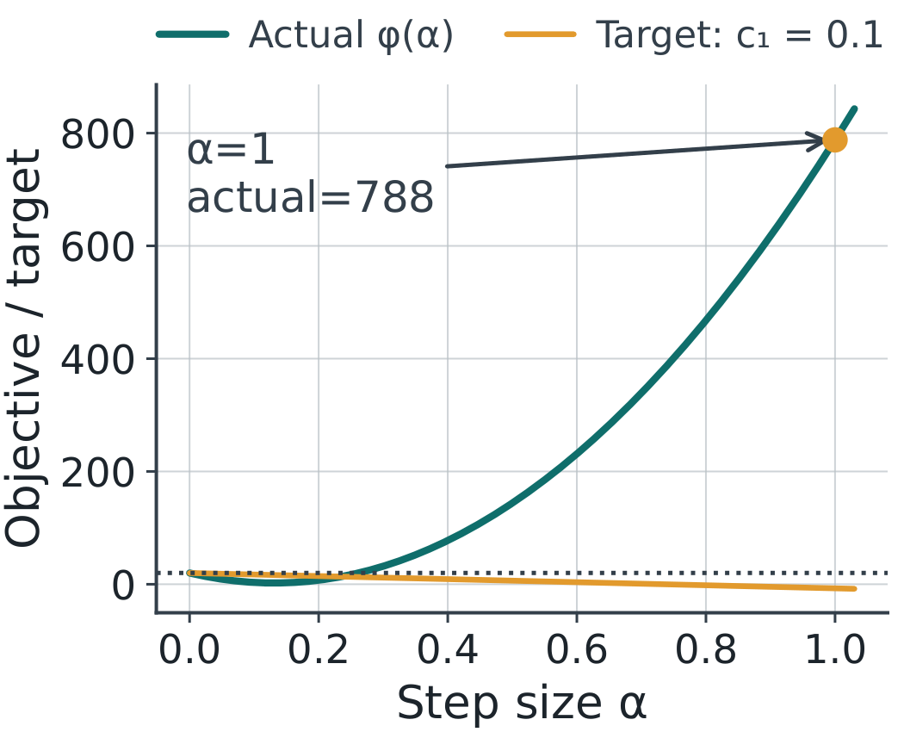
Trial 1: α=1
Actual value: φ(1)=788
Armijo target: 20 + 0.1(1)(−272) = −7.2
788 > −7.2: reject and halve α.
2105623 · Onsite workshop
41 / 58
Notes:
Actual value: φ(1)=788
Armijo target: 20 + 0.1(1)(−272) = −7.2
788 > −7.2: reject and halve α.
Reference for line search: Boyd and Vandenberghe, Convex Optimization, Chapter 9. https://web.stanford.edu/~boyd/cvxbook/

Slide 42
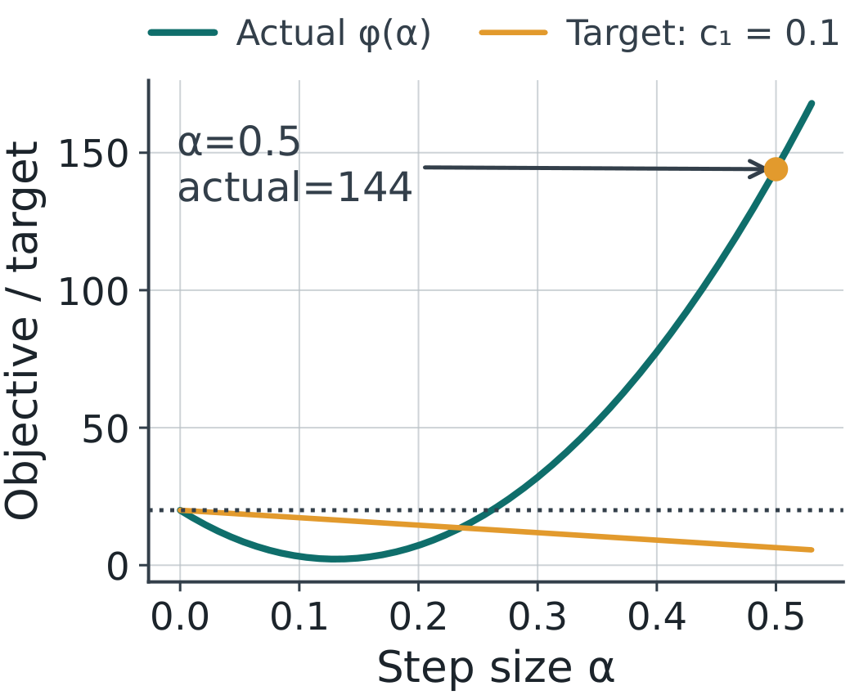
Trial 2: α=0.5
Actual value: φ(0.5)=144
Armijo target: 20 − 27.2(0.5) = 6.4
144 > 6.4: reject and halve α.
2105623 · Onsite workshop
42 / 58
Notes:
Actual value: φ(0.5)=144
Armijo target: 20 − 27.2(0.5) = 6.4
144 > 6.4: reject and halve α.
Reference for line search: Boyd and Vandenberghe, Convex Optimization, Chapter 9. https://web.stanford.edu/~boyd/cvxbook/

Slide 43
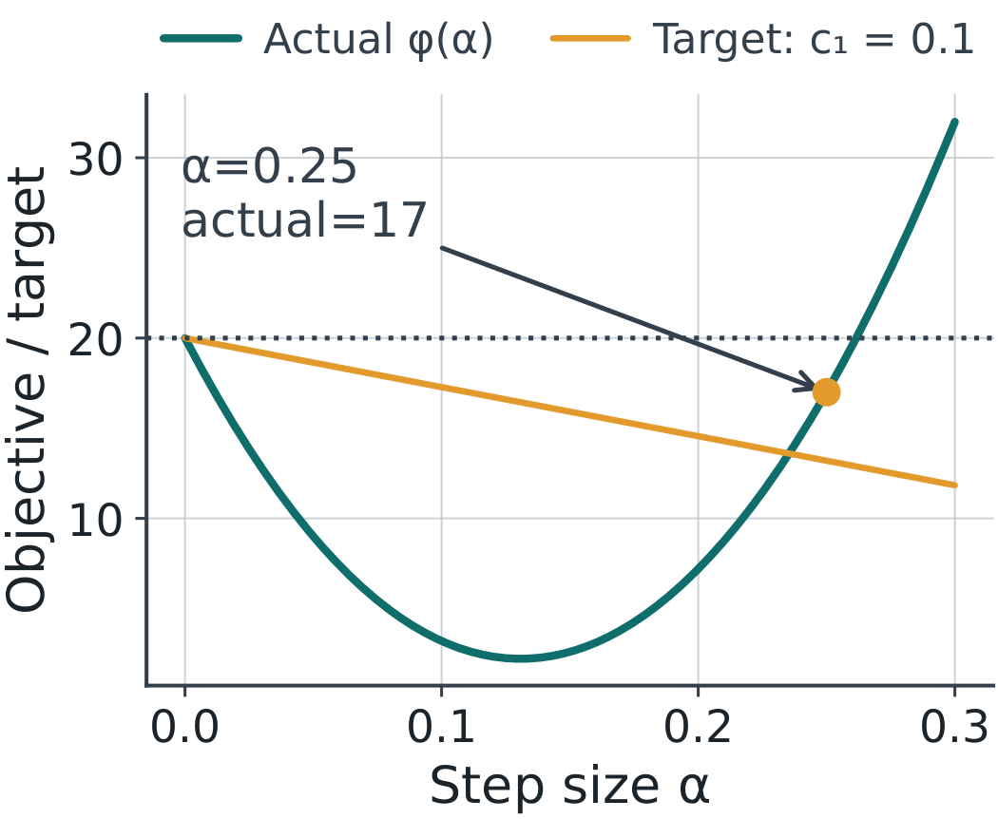
Trial 3: α=0.25
Actual value: φ(0.25)=17
Armijo target: 20 − 27.2(0.25) = 13.2
17 > 13.2: reject, even though 17 < 20.
2105623 · Onsite workshop
43 / 58
Notes:
Actual value: φ(0.25)=17
Armijo target: 20 − 27.2(0.25) = 13.2
17 > 13.2: reject, even though 17 < 20.
Reference for line search: Boyd and Vandenberghe, Convex Optimization, Chapter 9. https://web.stanford.edu/~boyd/cvxbook/

Slide 44
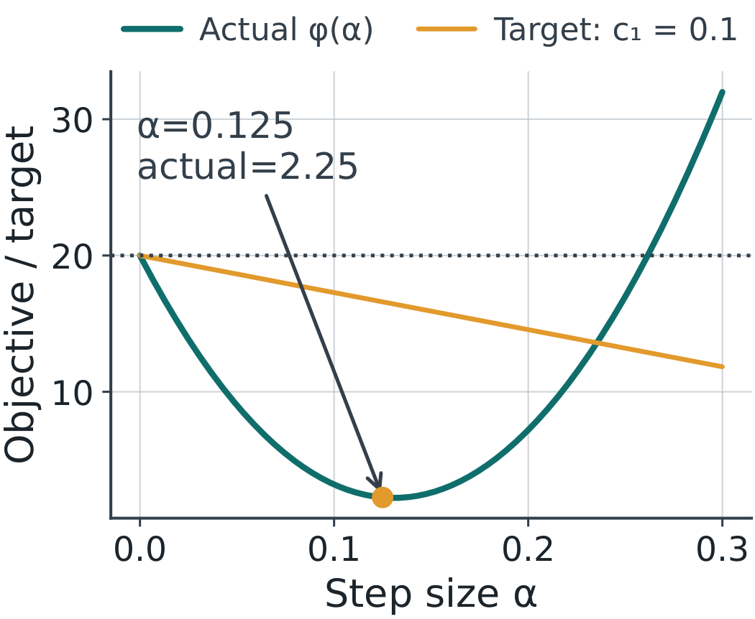
Trial 4: α=0.125
Actual value: φ(0.125)=2.25
Armijo target: 20 − 27.2(0.125) = 16.6
2.25 ≤ 16.6: accept r₁=(2.5,−2).
2105623 · Onsite workshop
44 / 58
Notes:
Actual value: φ(0.125)=2.25
Armijo target: 20 − 27.2(0.125) = 16.6
2.25 ≤ 16.6: accept r₁=(2.5,−2).
Reference for line search: Boyd and Vandenberghe, Convex Optimization, Chapter 9. https://web.stanford.edu/~boyd/cvxbook/

Slide 45
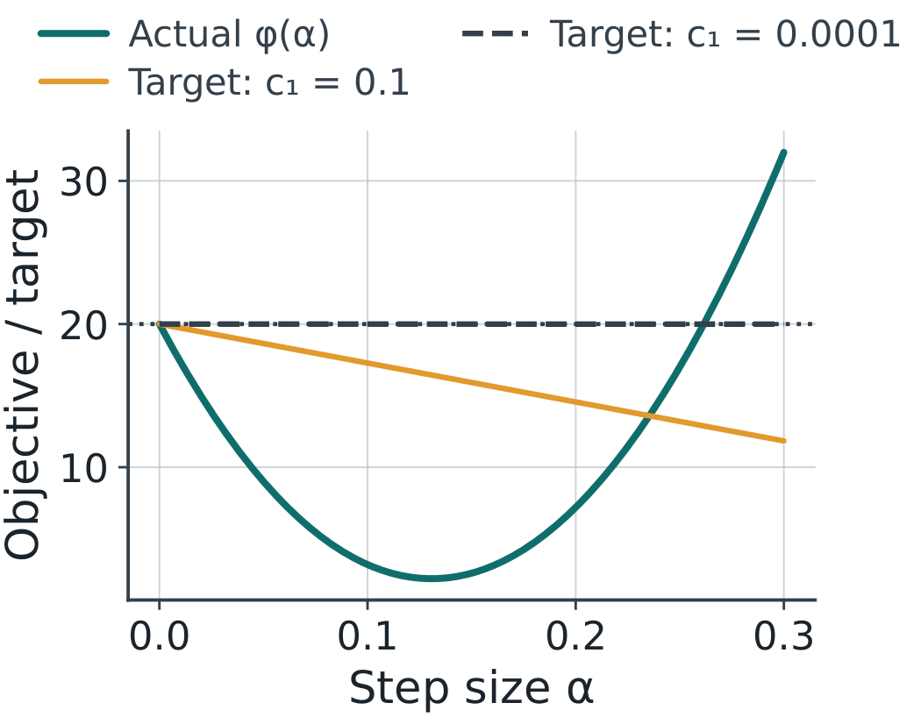
Acceptance depends on c₁
With c₁=0.0001, α=0.25 passes the first search.
Its target is 19.9932, and the actual value is 17.
One accepted step does not justify keeping that α forever.
2105623 · Onsite workshop
45 / 58
Notes:
With c₁=0.0001, α=0.25 passes the first search.
Its target is 19.9932, and the actual value is 17.
One accepted step does not justify keeping that α forever.
Reference for line search: Boyd and Vandenberghe, Convex Optimization, Chapter 9. https://web.stanford.edu/~boyd/cvxbook/

Slide 46
The two loops
Outer loop: compute g and choose a descent direction p.
Inner loop: keep r,p fixed; test α, ρα, ρ²α, …
After acceptance: update r, then recompute g.
2105623 · Onsite workshop
46 / 58
Notes:
Outer loop: compute g and choose a descent direction p.
Inner loop: keep r,p fixed; test α, ρα, ρ²α, …
After acceptance: update r, then recompute g.
Reference for line search: Boyd and Vandenberghe, Convex Optimization, Chapter 9. https://web.stanford.edu/~boyd/cvxbook/

Slide 47
Demo 2: inspect each Armijo trial
Reset to (3,0), c₁=0.1, ρ=0.5.
Test 1 → 0.5 → 0.25 → 0.125; explain every decision.
Accept the step, then inspect the NEW gradient.
Open demo.html → armijo
2105623 · Onsite workshop
47 / 58
Notes:
Reset to (3,0), c₁=0.1, ρ=0.5.
Test 1 → 0.5 → 0.25 → 0.125; explain every decision.
Accept the step, then inspect the NEW gradient.
Reference for line search: Boyd and Vandenberghe, Convex Optimization, Chapter 9. https://web.stanford.edu/~boyd/cvxbook/

Slide 48
Practice: one-dimensional backtracking
Minimize f(x)=3x². Start at x=1, so p=−6.
Use α₀=1, c₁=0.1 and ρ=0.5.
Find the first accepted α and the new point.
2105623 · Onsite workshop
48 / 58
Notes:
Minimize f(x)=x². Start at x=2, so p=−4.
Use α₀=1, c₁=0.1 and ρ=0.5.
Find the first accepted α and the new point.
Reference for line search: Boyd and Vandenberghe, Convex Optimization, Chapter 9. https://web.stanford.edu/~boyd/cvxbook/

Slide 49
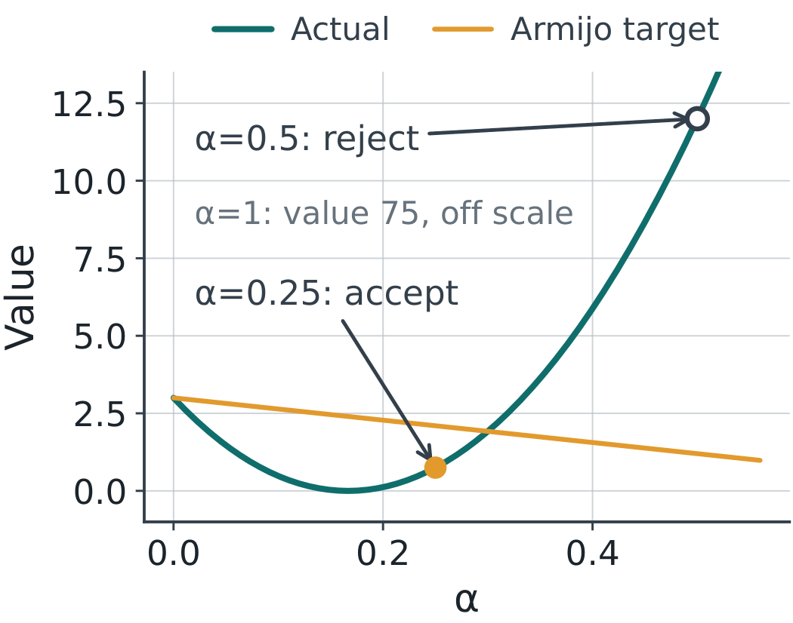
Practice solution
α=1: 75 > −0.6 and α=0.5: 12 > 1.2 → reject both.
α=0.25: actual 0.75 ≤ target 2.1 → accept.
New point x=−0.5: f drops from 3 to 0.75, but x* = 0.
2105623 · Onsite workshop
49 / 58
Notes:
α=1: 75 > −0.6 and α=0.5: 12 > 1.2 → reject both.
α=0.25: actual 0.75 ≤ target 2.1 → accept.
New point x=−0.5: f drops from 3 to 0.75, but x* = 0.
Reference for line search: Boyd and Vandenberghe, Convex Optimization, Chapter 9. https://web.stanford.edu/~boyd/cvxbook/

Slide 50
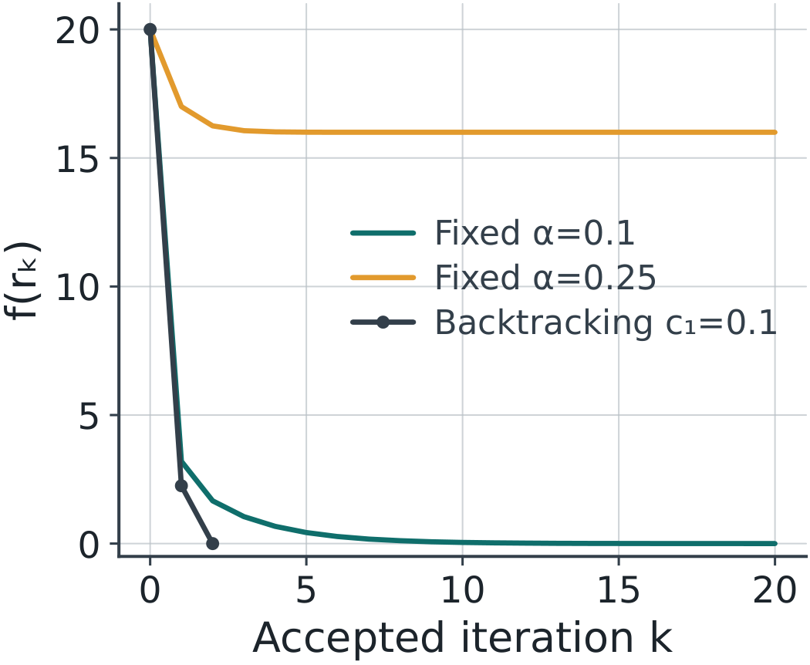
Compare complete runs
Use the same start (3,0) for every method.
Fixed α=0.1 converges; fixed α=0.25 stalls above 0.
Backtracking (c₁=0.1) reaches (1,−2) in two steps; exact arrival is special to this example.
Open demo.html → gd
2105623 · Onsite workshop
50 / 58
Notes:
Use the same start (3,0) for every method.
Fixed α=0.1 converges; fixed α=0.25 stalls above 0.
Backtracking (c₁=0.1) reaches (1,−2) in two steps; exact arrival is special to this example.
Reference for line search: Boyd and Vandenberghe, Convex Optimization, Chapter 9. https://web.stanford.edu/~boyd/cvxbook/

Slide 51
Python demonstration
Run line_search_lab.py or open the notebook.
Print α, actual value, target and accept/reject.
Change the start or c₁, then explain the new trace.
2105623 · Onsite workshop
51 / 58
Notes:
Run line_search_lab.py or open the notebook.
Print α, actual value, target and accept/reject.
Change the start or c₁, then explain the new trace.
Reference for line search: Boyd and Vandenberghe, Convex Optimization, Chapter 9. https://web.stanford.edu/~boyd/cvxbook/

Slide 52
Stopping and reporting
Check ‖g‖, objective, iteration count and finite values.
A tiny step or small change can mean stagnation.
For nonconvex problems, also inspect curvature and multiple starts.
2105623 · Onsite workshop
52 / 58
Notes:
Check ‖g‖, objective, iteration count and finite values.
A tiny step or small change can mean stagnation.
For nonconvex problems, also inspect curvature and multiple starts.
Reference for line search: Boyd and Vandenberghe, Convex Optimization, Chapter 9. https://web.stanford.edu/~boyd/cvxbook/

Slide 53
Line search cannot repair every direction
For q at x=0.2: Newton gives p≈−0.21818 and gp>0.
Small positive steps in this direction increase q.
Replace the direction, for example with p=−g, before descent search.
Open demo.html → newton
2105623 · Onsite workshop
53 / 58
Notes:
For q at x=0.2: Newton gives p≈−0.21818 and gp>0.
Small positive steps in this direction increase q.
Replace the direction, for example with p=−g, before descent search.
Reference for line search: Boyd and Vandenberghe, Convex Optimization, Chapter 9. https://web.stanford.edu/~boyd/cvxbook/

Slide 54
BFGS: a preview
Gradient descent uses p=−g.
Newton solves Hp=−g using the Hessian.
BFGS updates a curvature approximation using changes in r and g.
2105623 · Onsite workshop
54 / 58
Notes:
Gradient descent uses p=−g.
Newton solves Hp=−g using the Hessian.
BFGS updates a curvature approximation using changes in r and g.
Reference for line search: Boyd and Vandenberghe, Convex Optimization, Chapter 9. https://web.stanford.edu/~boyd/cvxbook/

Slide 55
Opening questions: answers
Prices bound profit only if dual feasible: (1,0) gives w = 4 < 9.
∇f = 0 is not enough: x = 0 is a local maximum of q.
A descent direction can still fail: α = 1 and 0.5 increase f.
2105623 · Onsite workshop
55 / 58
Notes:
Prices bound profit only if dual feasible: (1,0) gives w = 4 < 9.
∇f = 0 is not enough: x = 0 is a local maximum of q.
A descent direction can still fail: α = 1 and 0.5 increase f.
Reference for line search: Boyd and Vandenberghe, Convex Optimization, Chapter 9. https://web.stanford.edu/~boyd/cvxbook/

Slide 56
Exit check
Why was α=0.25 rejected when c₁=0.1?
What stays fixed during the inner backtracking loop?
What must be checked before a descent line search?
2105623 · Onsite workshop
56 / 58
Notes:
Why was α=0.25 rejected when c₁=0.1?
What stays fixed during the inner backtracking loop?
What must be checked before a descent line search?
Reference for line search: Boyd and Vandenberghe, Convex Optimization, Chapter 9. https://web.stanford.edu/~boyd/cvxbook/

Slide 57
Exit check: answers
17 > 13.2: the decrease is insufficient for this target.
Keep the current point r and direction p fixed.
Check gᵀp < 0. If g = 0, stop and classify the point.
2105623 · Onsite workshop
57 / 58
Notes:
17 > 13.2: the decrease is insufficient for this target.
Keep the current point r and direction p fixed.
Check gᵀp < 0. If g = 0, stop and classify the point.
Reference for line search: Boyd and Vandenberghe, Convex Optimization, Chapter 9. https://web.stanford.edu/~boyd/cvxbook/

Slide 58
Next: constrained nonlinear optimization
Feasible directions and active constraints
Lagrange multipliers and KKT as optimality conditions
How practical constrained solvers use local models
2105623 · Onsite workshop
58 / 58
Notes:
Feasible directions and active constraints
Lagrange multipliers and KKT as optimality conditions
How practical constrained solvers use local models
Reference for line search: Boyd and Vandenberghe, Convex Optimization, Chapter 9. https://web.stanford.edu/~boyd/cvxbook/

